Slide 1
Shri sadguru saibaba science & COMMERCE college, ashti
Subject – Zoology
B.Sc Part II Semester IV
Paper II – General physiology and Biochemistry II
Unit I
Power point presentaion on
‘ Excretion and osmoregulation’
by
Dr. P R Chavhan
Assistant Professor & Head
Department of Zoology
Shri Sadguru Saibaba Science & Commerce college, Ashti, Dist.Gadchiroli

Slide 2
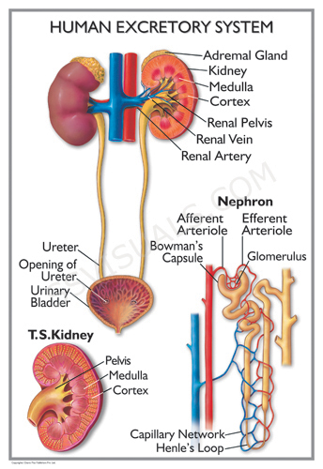
Excretion

Slide 3
Excretory System
A pair of kidney – blood filteration, urine formation
A pair of Ureter – carries urine from kidney to urinary bladder
Urinary bladder – store urine
Erethra – removal of urine

Slide 4
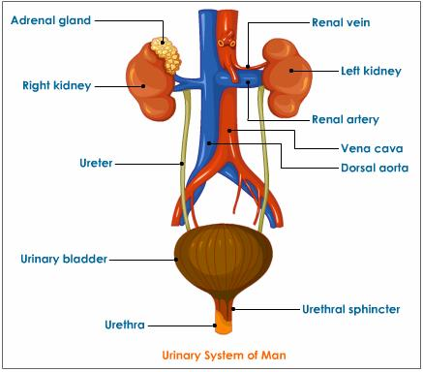
Urinary system

Slide 5
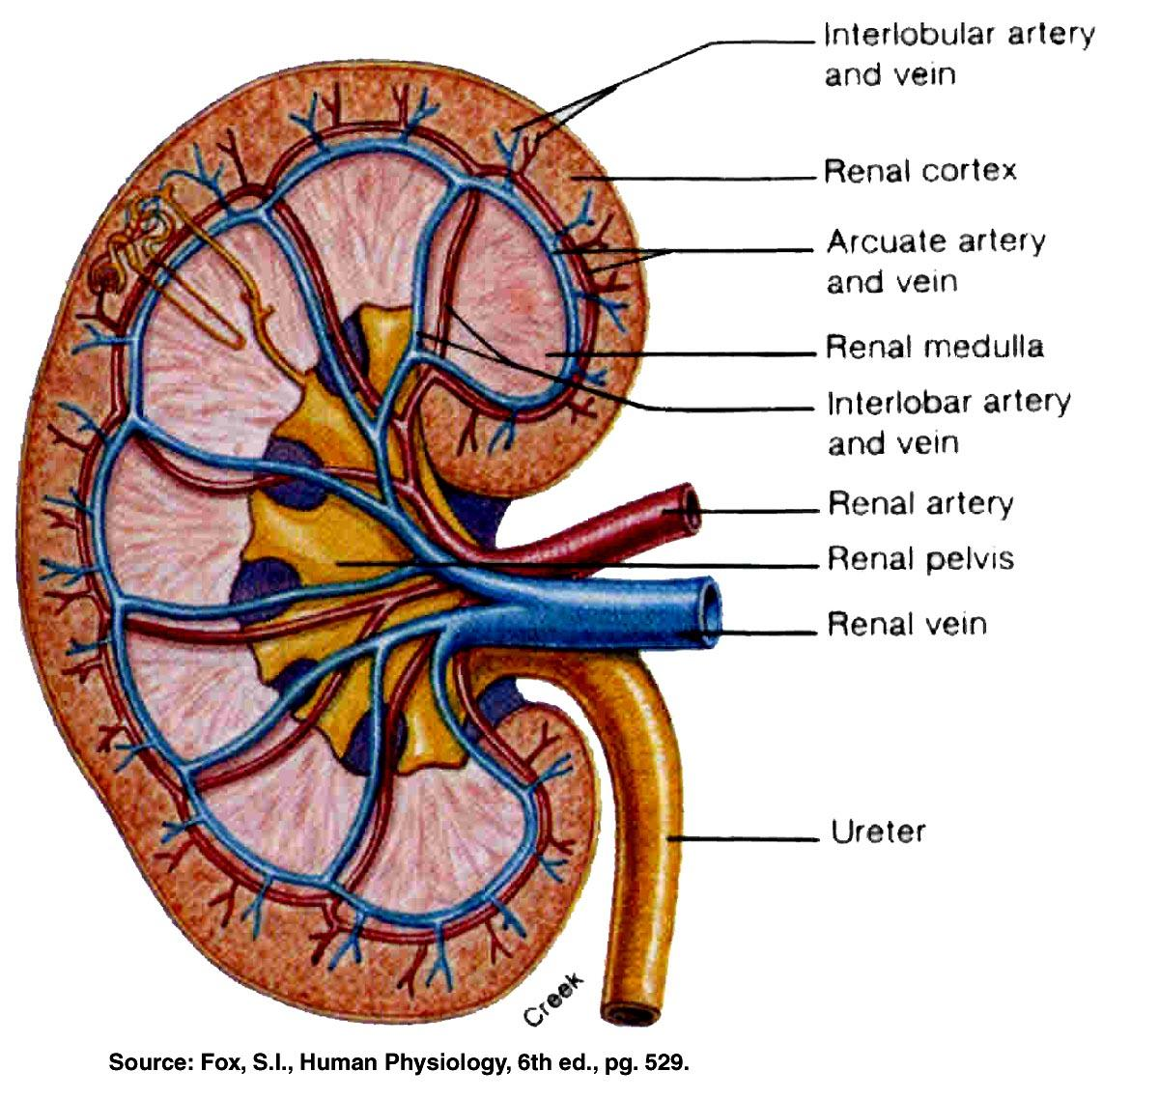
L.S.Kidney

Slide 6
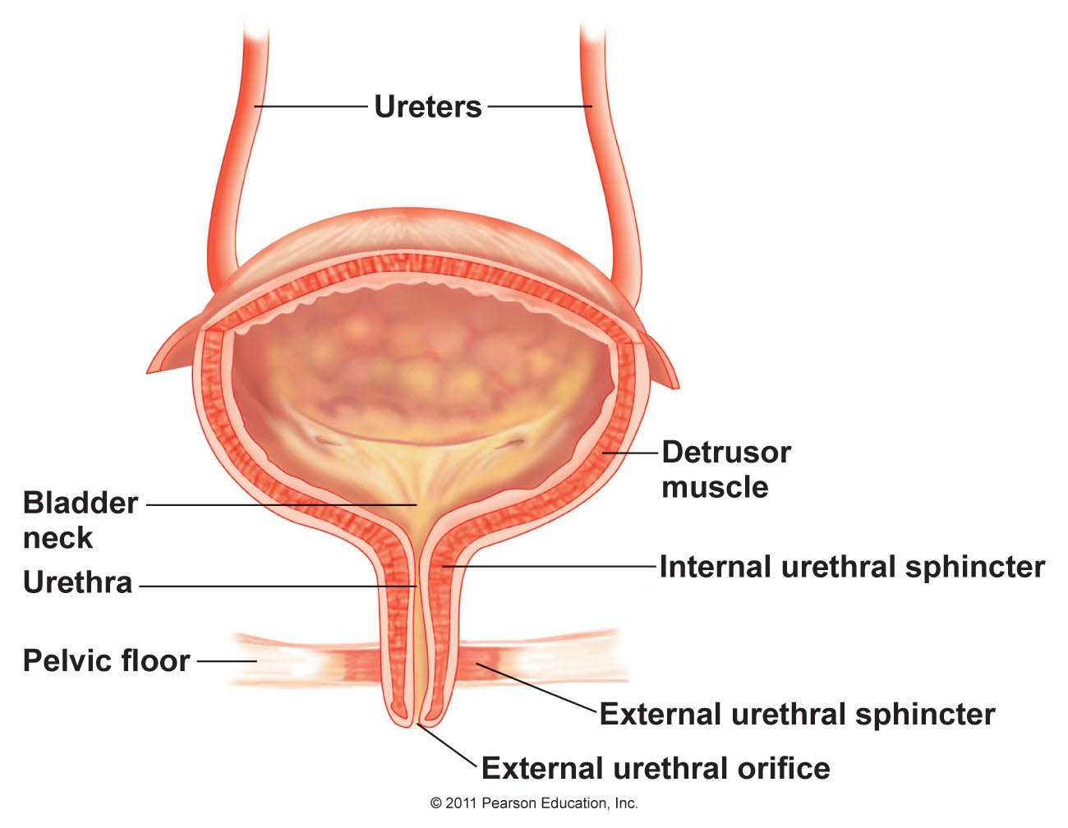
Urinary bladder

Slide 7
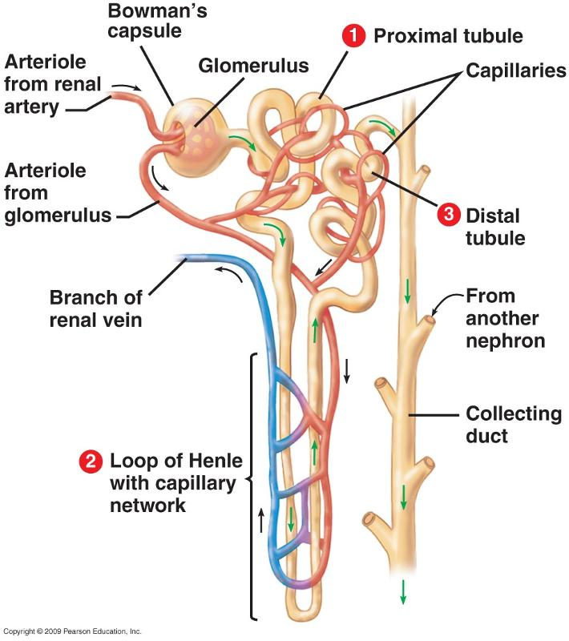
Structure of nephron
Structure of nephron –
Nephron is functional unit of kidney.
A nephron is thin walled,long coiled duct lined by lined by single layer of epithelial cells. The nephron along with collecting tubule is also called uriniferous tubule.
Nephorn is divided into two region.
1.Bowmans capsule 2.Renal tubule
Bowman’s capsule and glomerulas are together called Malpighian body or renal corpuscle.
Bowmn’s capsule is proximal blind end of nephron. It is two layered outer layer is parietal layer and inner visceral layer.
Renal tubule divided into PCT , Loop of henle and DCT.
PCT is highly coiling duct.
Loop of henle is U shaped structure divided into descending limb and ascending limb.
DCT is also coiled. It is open into collecting tubule or duct of bellini.
Collecting tubule open into calyx of the medullary pyramid.
Entire renal tubule embedded within network of capillaries called peritubular capillaries.
Peritubular capillaries are formed by efferent renal arteriole. These capillaries join to form a venule. Venule join to form vein.
DCT is close to glomerulas of same nephron and forms complex structure called juxta glomerular apparatus. It secretes enzyme renin that controls the blood pressure.

Slide 8
Structure of nephron
Nephron (Uriniferous tubule)
Malpighian Capsule Renal tubule
OR
Renal corpuscle
Proximal Loop of henle Distal
convoluted convoluted
tubule tubule
Glomerulas Bowman’s capsule
Descending limb Ascending limb

Slide 9
Mechanism of urine formation
Three stages involved in process of urine formation
Ultrafiltration
Selective reabsorption
Tubular secretion

Slide 10
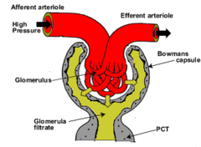
Mechanism of urine formation
1.Ultrafiltration
It is physical process taking place in the malphigian body.
Glomerulas and Bowmans capsule act as filtering unit.
In this process blood get filtered by hydrastatic mechanism in glomerulus.
Glucose, amino acid, salts, urea etc.readily filtered.
Blood cells, plasma proteins and large fat molecules are unable to filter through glomerular capillaries.
About 125 ml per minute of filterate is formed. It is called glomerular filterate rate( GFR).
99% filterate is reabsorbed and only 1- 1.5 liters of urine is formed.
2. Selective reabsorption
This process includes two process depending upon concentration gradient.1. Passive transport along the gradient 2. Active transport – against gradient by using ATP molecules.
Selective reabsorption occurs between renal tubule and peritubular capillaries.
High threshold substances like glucose and amino acid completely reabsorbed.Water is reabsorbed by osmosis in PCT, DCT and descending limb of loop of henle.
Na,AA, ions like K, ca and Chloride ion are reabsorbed by active transport.
Malpighian body

Slide 11
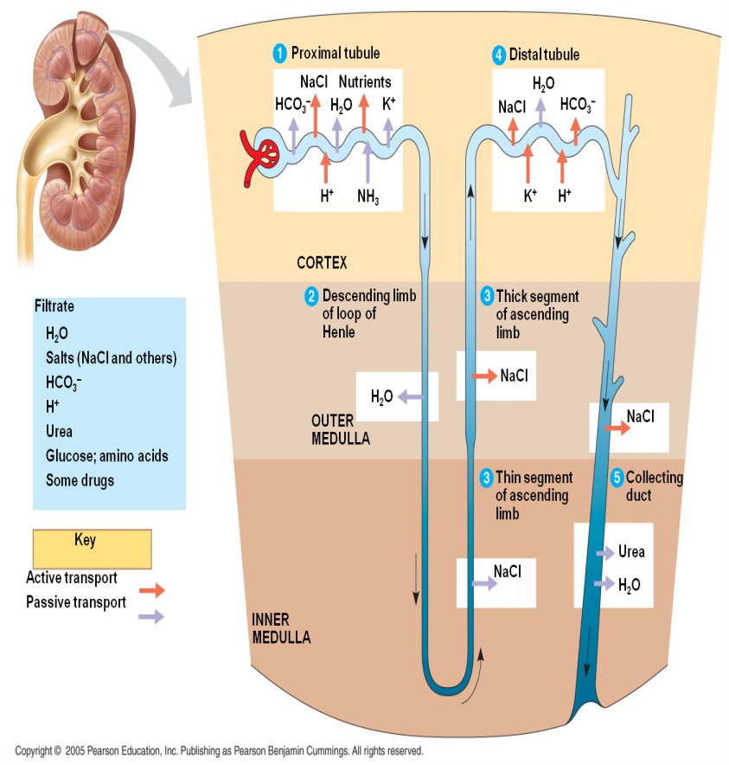
Selective reabsorption and tubular secertion
2. Selective reabsorption
This process includes two process depending upon concentration gradient.1. Passive transport along the gradient 2. Active transport – against gradient by using ATP molecules.
Selective reabsorption occurs between renal tubule and peritubular capillaries.
High threshold substances like glucose and amino acid completely reabsorbed.Water is reabsorbed by osmosis in PCT, DCT and descending limb of loop of henle.
Na,AA, ions like K, ca and Chloride ion are reabsorbed by active transport.
3. Tubular secretion
In this process peritubular capillaries secrete potassium ,creatinine and Hydrogen ions.
Secretion of hydrogen which takes place in DCT and collecting tubule is important for homeostatic regulation of acidity of blood.
Some abnormal substances found in the blood are secreted into urine like penicillin, iodine containing compound iodopyracet are secreted out into urine.

Slide 12
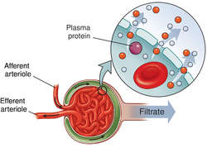
Glomerular filteration

Slide 13
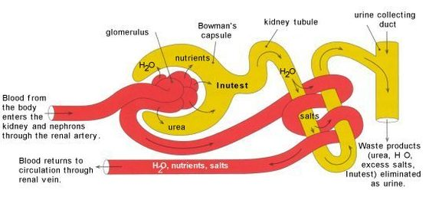
Rout of blood flow and urine formation

Slide 14
Normal Constituents of urine
A) Urea – Main end product of catabolism of protien in mammals.
B) Ammonia – Formed by kidney from glutamine or amino acids in acidosis.
C) Creatinine and creatine – Creatine is excreted by children and pregnant women and much smaller amount in men. The excretion in men is 6% of total excretion of creatinine . Creatinine is formed from creatine.
D) Uric acid – It is end product of oxidation of purines in the body. Uric acid excretion increased in leukemia, severe liver disease and various stages of gout.
E) Amino acid – Increased amount of amino acids are excreted in liver disease and in certain types of poisoning. In cystinuria , 4 amino acids – arginine, cystine, lysine and ornithine are exreted in urine.
F) Allontoin – It is the partial oxidative product of uric acid. Small quantities of allontoin are excreted in human urine.
G) Sulphates – The urine sulphur is derived from sulphur containing amino acids such as methionine and cystine.
H) Chlorides – Excreted as NaCl and output varies with intake.
I) Phosphates – Consist of sodium and pottasium phosphates also calcium and magnesium phosphates.
J) Minerals – 4 cations of extracellular fluid –sodium, pottasium, calcium and magnesium are present in urine
K) Enzymes – Traces of many enzymes are excreted in urine pancreatic amylase, pepsin, trypsin and lipase.
L) Hormones and vitamins – Sex hormones and vitamin (e.g. Band C) are found in urine.
M) Oxalate – The amount of oxalate is found in the urine is low( 20 mg/day) and found as calcium oxalate crystals.

